Slide 1
NISARGA BIOTECH PVT. LTD.
Marketed & Distributed by - ECOLIFE TRADERS LLP, Pune
Satyajit Rakshe
Director,
ECOLIFETRADERSLLP@Gmail.com
+91 9822-854-111

Slide 2
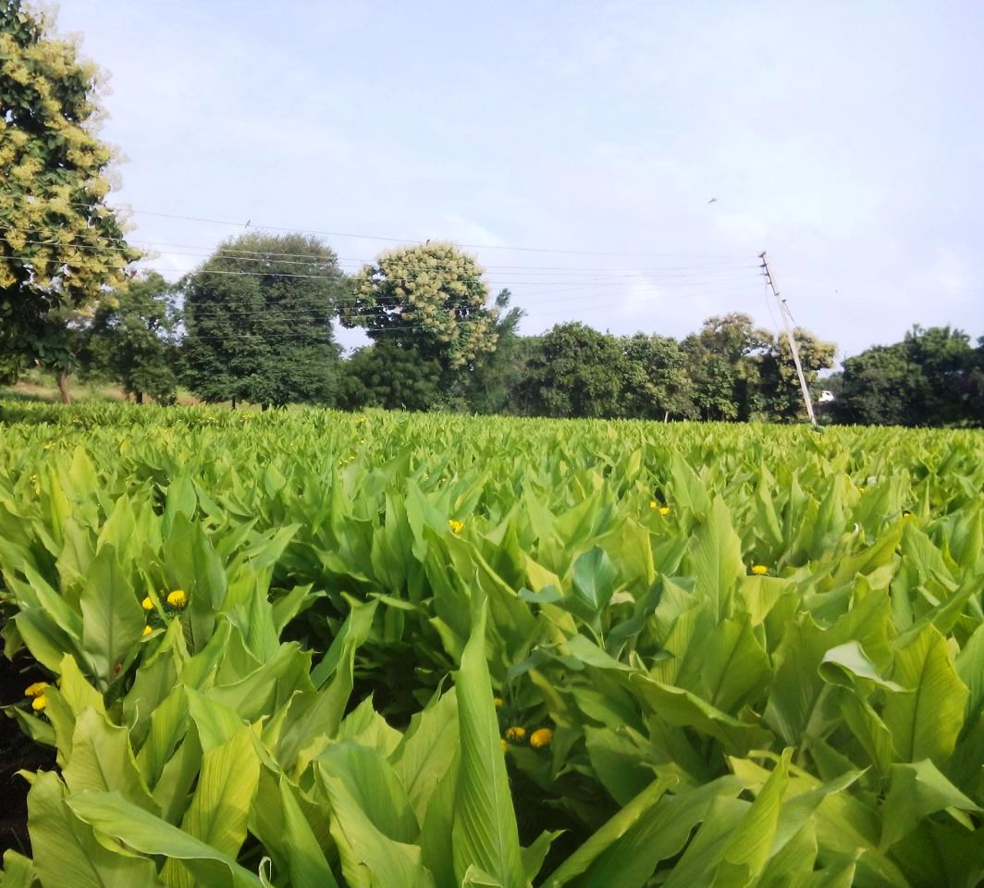
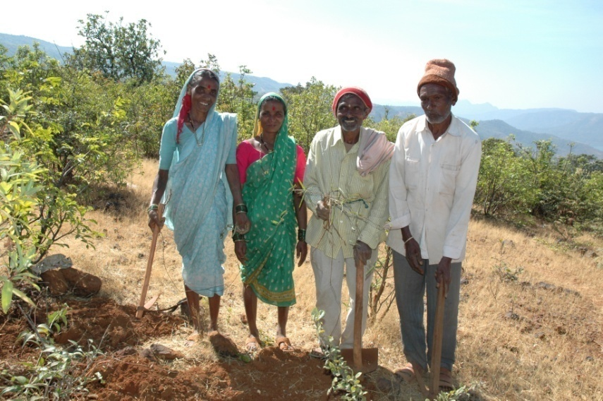
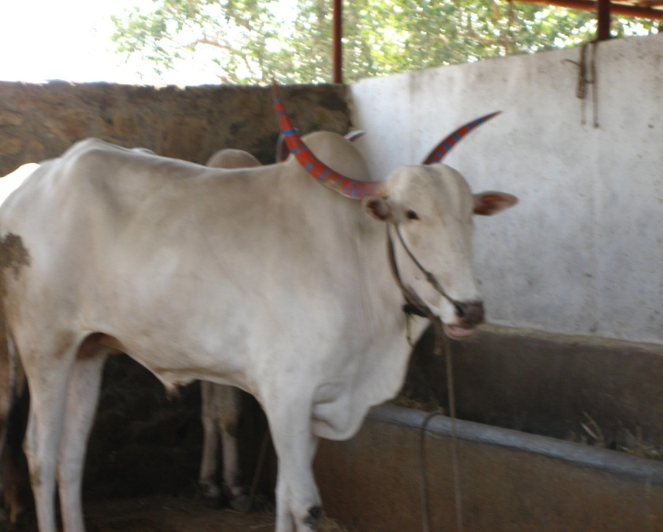
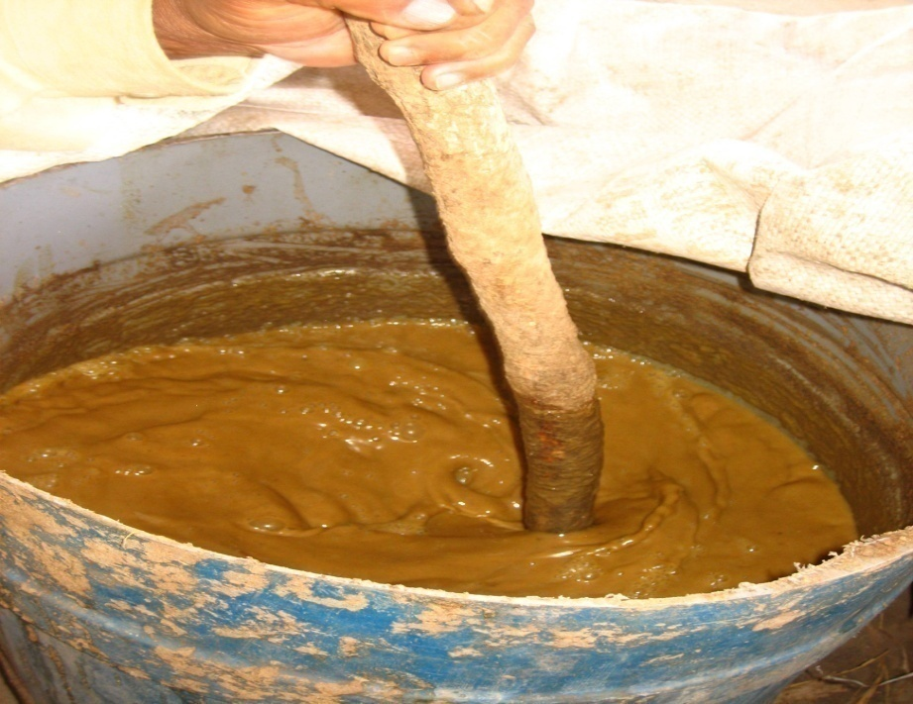
We have our own 50 acres of organic farms & about 150 acres of contracted farms which are certified organic by EcoCert
Our commitment includes educating farmers in organic & biodynamic agriculture

Slide 3
What is organic certification in India and what does it entail?
A 3rd party which is accepted throughout the world as a certifier of organic products
They do quarterly audits to ensure that materials are in fact organic in nature and not just claimed so for business purposes
They do field testing and soil testing to ensure that no chemical means are used in growing and protecting crops
Production methods are validated to ensure noninfringement of organic standards set internationally
They ensure sustainability of organic materials
They ensure and audit traceability of materials from farm to shelf through a national record system

Slide 4
Our commitment
"Nisarga" can be translated to mean nature. This nature is demonstrated by our commitment to enriching the earth and supporting healthy livelihoods with organic agriculture.
All our operations are in compliance with cGMP. We are FSSC(Food Safety System Certification) certified and have ISO 22000:2005
We use certified organic and/or ethically wild crafted herbs for making our extracts and we have complete control on the manufacturing process from farm to the end product.
Our extracts and manufacturing facilities are certified organic by ECOCERT SA France and we also have “For Life” certification from IMO, Switzerland confirming our commitment to organic farming and social responsibility in treating all the stake holders like Farm workers, farmers and our factory workers and employees in the fairest possible manner.
Notes:
Trained more than 100,000 farmers in sustainable organic farming for more than 20 yrs ensuring a constant supply of good quality raw materials

Slide 5
Organic farms
Umbari Organic farm

Slide 6
Nitral Organic farm
Organic farms

Slide 7
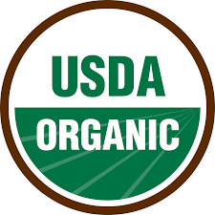
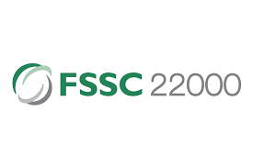
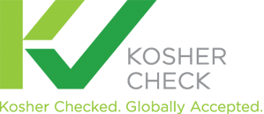
certifications
Certified organic by Ecocert, France
System certifications
Certified Halal and kosher
Certified ‘for life’ by IMO Swiss AG.

Slide 8
Highlights and Scientific achievements
Two US patents (patent no. US8110229B2 and US8394429B2) for treatment of ADHD & memory enhancement
1 Indian patent for combining supercritical CO2 extracts with hydrophilic extracts for therapeutic efficacy
US FDA compliant facility used for manufacture of extracts
Nisarga products successful in the USA for over 17 years.
Awarded best nutritional supplement of the year 2015 by Better Nutrition magazine in the USA for Nurofocus, our ADHD product
Awarded Pharmexcil award for best patent in herbal products by The Indian export council for pharma products for treatment of ADHD & memory enhancement
One US patent pending for use of CO2 extracts for use in 100% natural therapeutic vapors
Notes:
Towards end of ppt

Slide 9
Our prestigious clients around the world
Estee Lauder, USA
Aveda Corporation, USA
Nutraceutical International Corporation, USA
Himalaya, USA
Advantage Health, USA
Pukka Herbs, UK
Dabur, Dubai

Slide 10
US FDA compliant safety standards at every stage
Tested for heavy metals using state of the art AS
Tested for microbial load, pathogens using modern micro-labs approved by the Department of Science and Industrial Research, Govt. Of India.

Slide 11
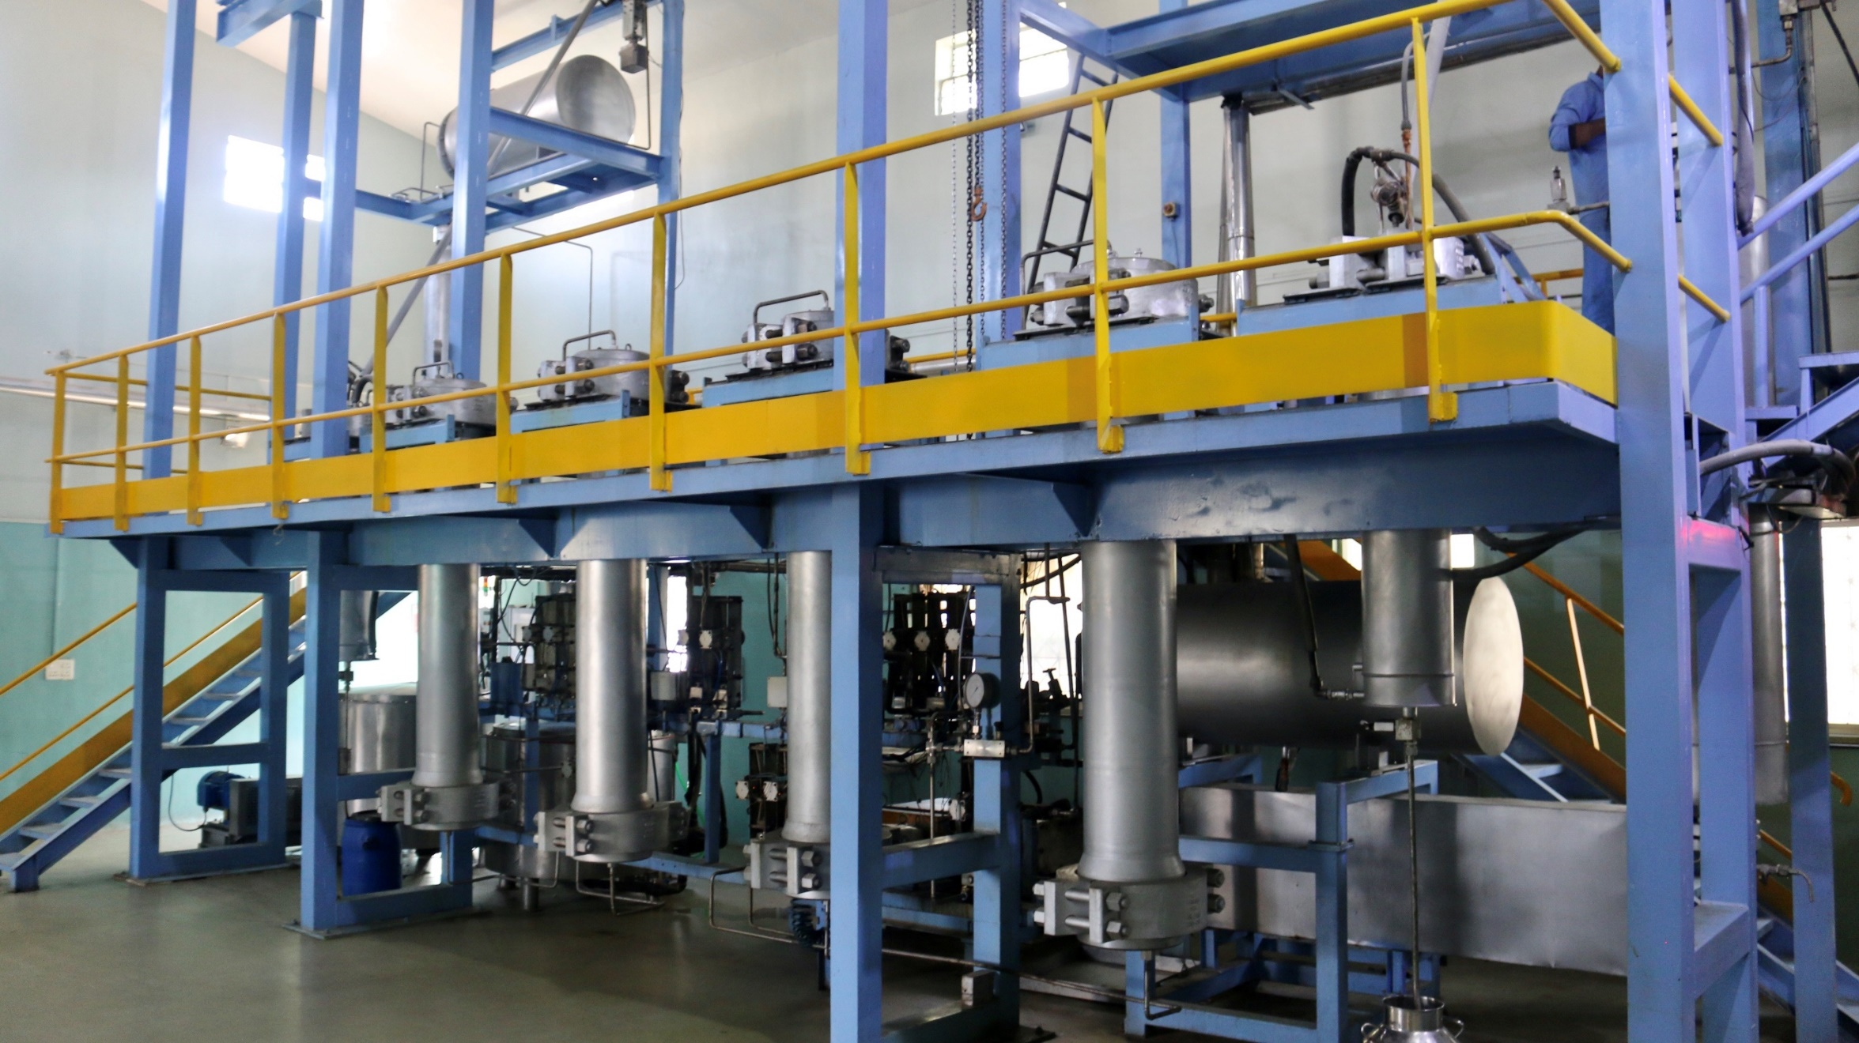
Processing facility
We can process 400 MT of raw material a year
We have a 2x25 liter, 2x50 liter and two 2x100 liter machines
All machines are electronically controlled and automated to highest degree

Slide 12
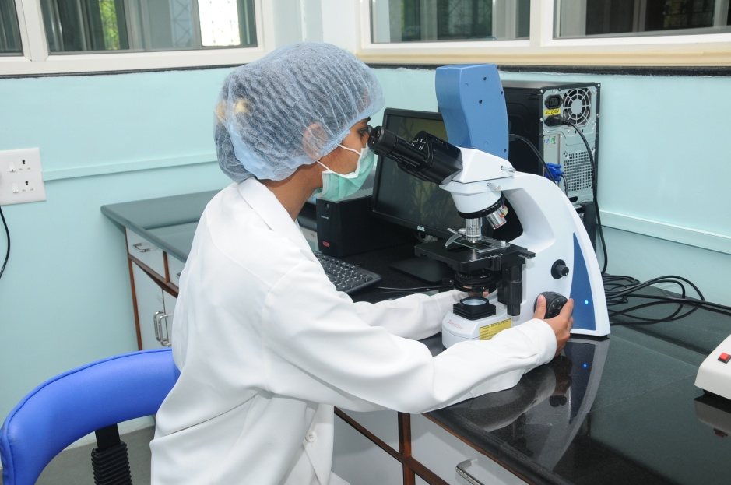
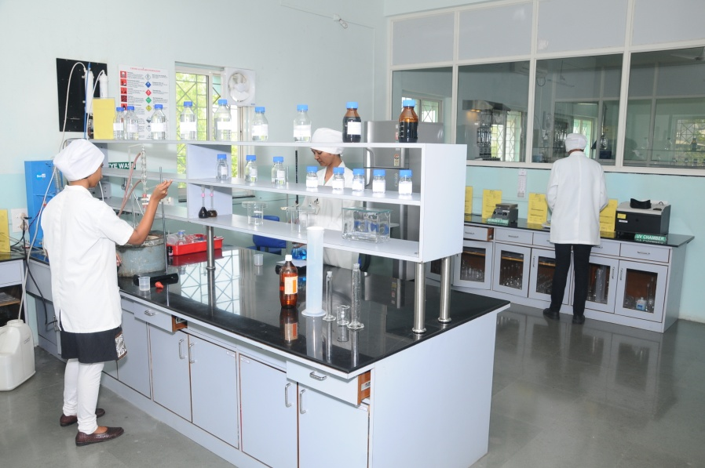
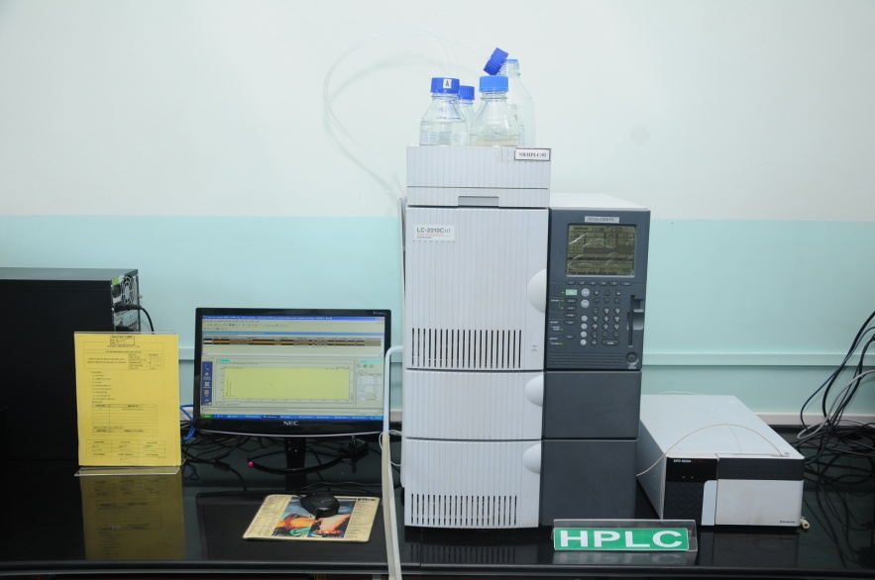
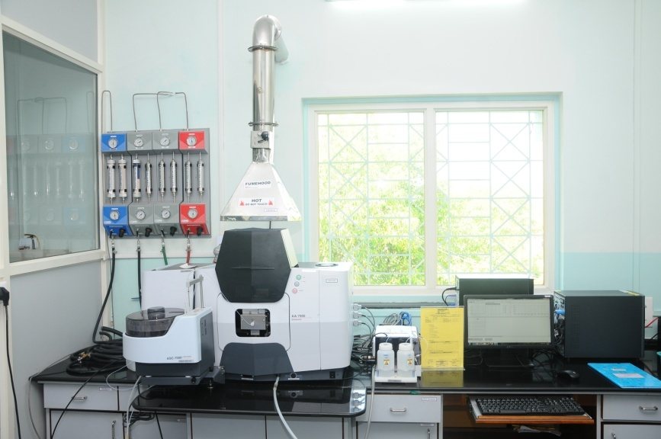
Our Well Equipped In House Testing and Formulation Labs
Microlab
Physical Testing
Instrumentation lab

Slide 13
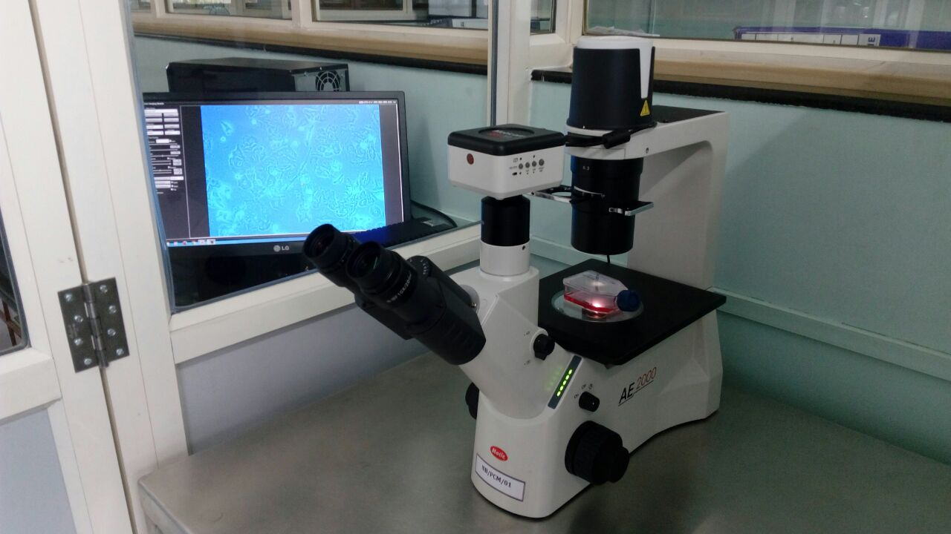
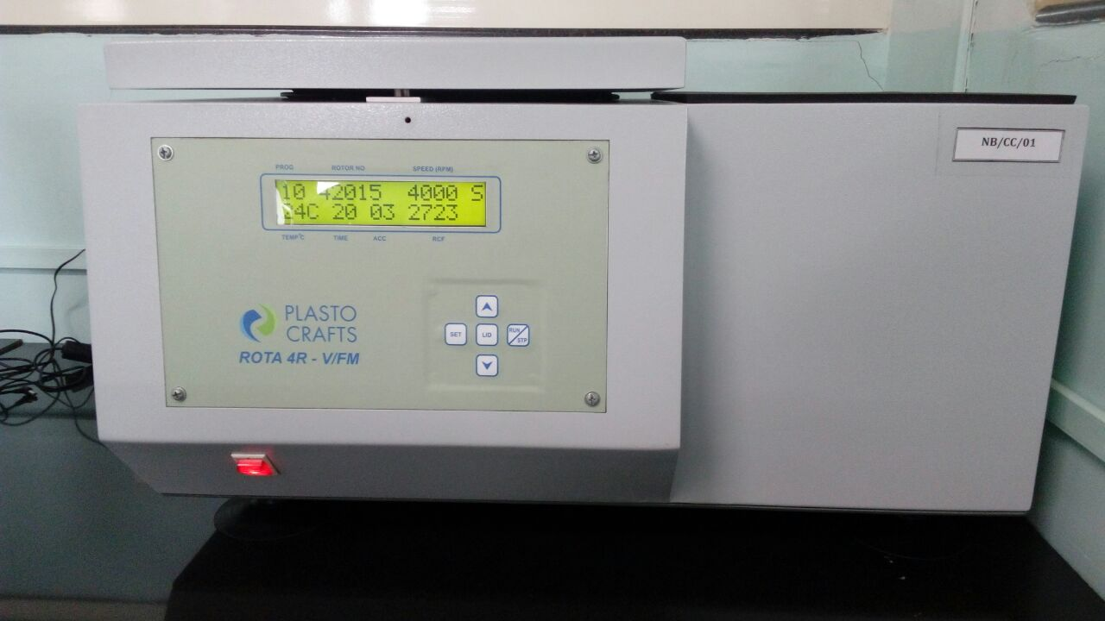
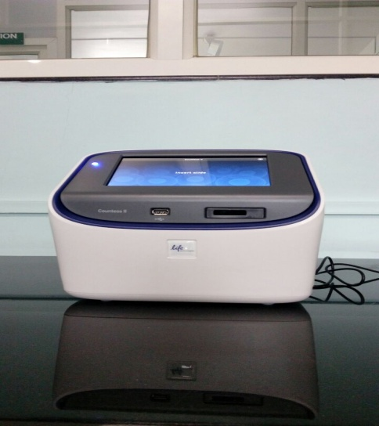
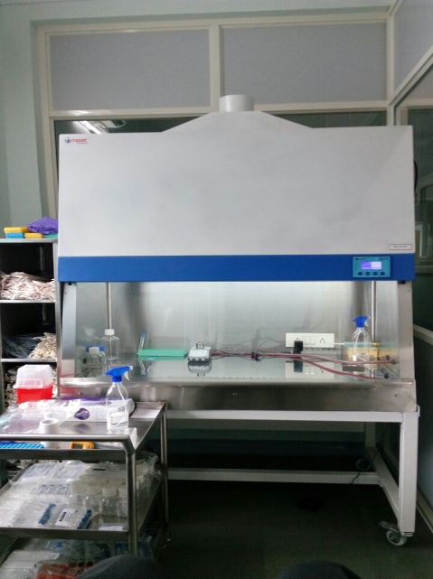
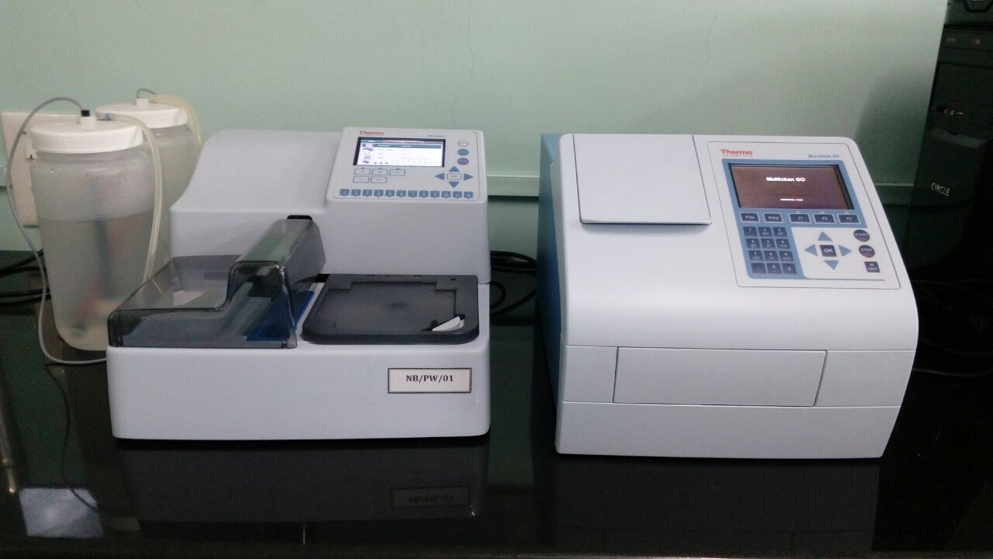
Cell line lab for research on the extracts
Cooling centrifuge
Phase contrast microscope
automatic cell counter
Eliza plate reader and washer
Bio-safety cabinets

Slide 14
What is CO₂ extraction?

Slide 15
Advantages of using CO₂ extracts.
Highly concentrated extracts means low dosage levels and better stability and shelf life for end Products.
Closest organoleptic profile to the raw botanicals.
No chemical and solvent residues.
High concentration of minor active ingredients means better efficacy.
Better shelf life due to co-extraction of antioxidants.
Due to lower separation temperature than extraction temperature molecular integrity of extracted product is retained.

Slide 16
Comparison of Extracts
Parameters | Water Extracts/ Hydro Alcoholic Extracts | Supercritical CO₂ Extracts
Organoleptic profile | Contains all polar ingredients & slightly non polar ingredients | Contain slightly polar & all non polar lypophylic ingredients
Retention of Temperature Sensitive ingredients | All temperature sensitive volatile ingredients are destroyed as process temperature is as high as 80⁰ to 100⁰C | All the volatile temperature sensitive ingredients are retained in the extract. (process temp 35⁰ to 45⁰C)
Structural changes in bioactive constituents | Hydrolysis may result in modification in bioactive constituents | Inert solvents ensure retention of bioactive constituents in the extracts without any structural changes
Notes:
Careophillin in clovebud oil is volatile
Eugenol acetate ring is broke n in high temps

Slide 17
Comparison of Extracts In terms of Contaminants
Parameter | Water Extracts/ Hydro Alcoholic Extracts | Supercritical CO₂ Extracts
Heavy Metals | High possibility as Heavy Metals are highly polar | Extracts are free from any Heavy Metal contamination
Microbial contamination | High possibility of microbial contamination due to presence of moisture | Very low microbial load in the resulting extract

Slide 18
Comparison of organoleptic profile of extracts
POLAR
NON POLAR
OH-
Conventional Water Extract
CH3
OH-
Hydroethanolic Extract0
CH3
OH-
Supercritical CO2 Extract
CH3

Slide 19
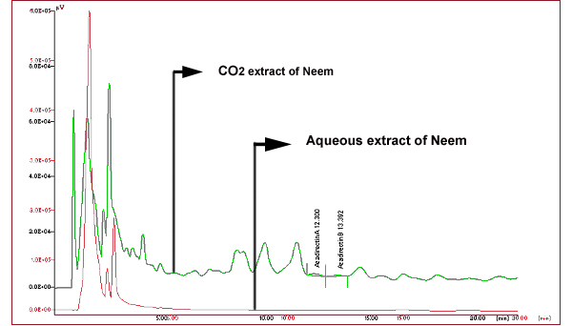
Neem leaf extract Comparison of HPLC profiles

Slide 20
Antioxidant & Anti-Inflammatory activity
Properties | Curcuma longa Turmeric | Zingiber officinale Ginger | Bacopa Monnieri Brahmi | Cellastrus Paniculata Jyotishmati | Ocimum sanctum Holy Basil
Antioxidant Results (%) | DPPH(diphenyl- 1-picrylhydrazyl) IC50= 0.02% | DPPH IC50= 0.001% | DPPH IC50= 0.1% | DPPH IC50= 0.1% | DPPH IC50= 0.0088%
Anti-inflammatory results (%) | 5-LOX IC50= 25.73 µg /ml | 5-LOX IC50 = 43.93 µg /ml | 5-LOX IC50 = 66.33 µg /ml | 5-LOX IC50 = 88.46 µg /ml | 5-LOX IC50= 73.64 µg /ml

Slide 21
Water soluble CO₂ Extracts
Although CO₂ extracts are very potent, they are all lipid soluble and cannot be used in products where base is water or water soluble liquid.
With Our special high shear stirring technology, we reduce the CO2 particle size so it stays suspended in water over long periods of time.
With the combination of highly potent CO₂ extracts and this technology you get an amazing combination in form of water soluble extracts which taste great, give the desired functional dose of herb as well as the desired effect in the body.

Slide 22
Where can water soluble CO₂ extracts be used?
Functional beverages
RTD(ready to drink) products
Functional waters
Food flavors and liquid spice mixes
Teas
Nutraceutical and cosmeceutical products with water base.
Demo video in next slide

Slide 23
Water soluble CO₂ extract Demo Video

Slide 24
Where can CO₂ extracts be used?

Slide 25
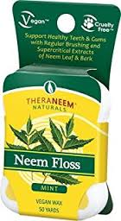
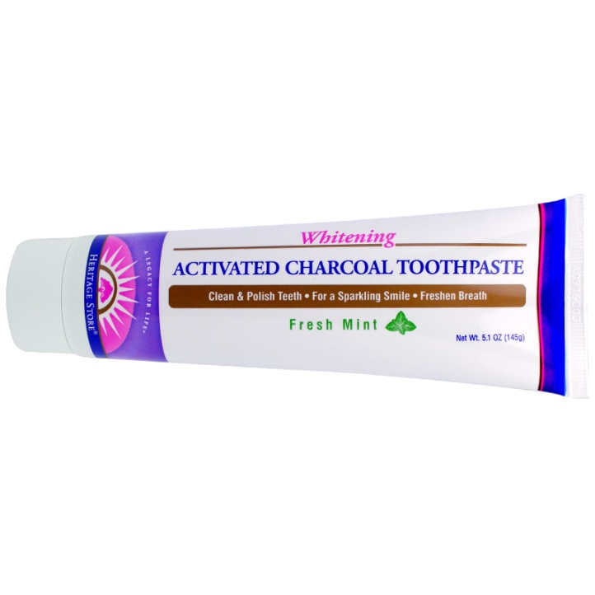
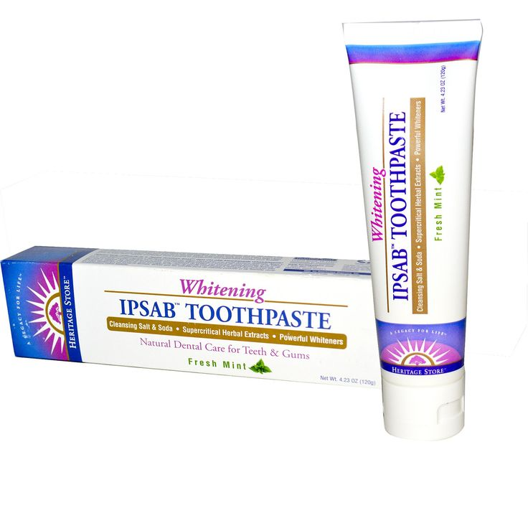
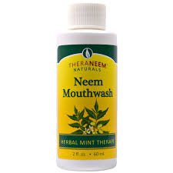
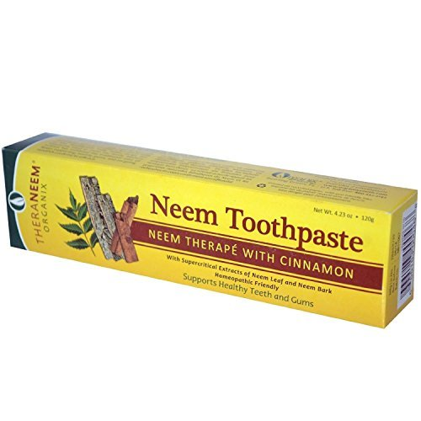
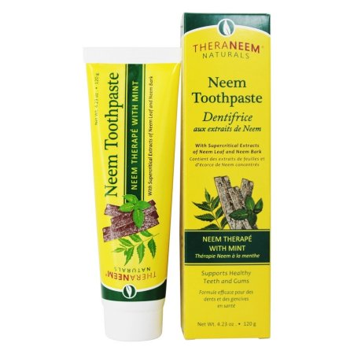
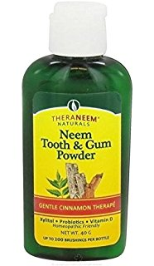
Oral Care products

Slide 26
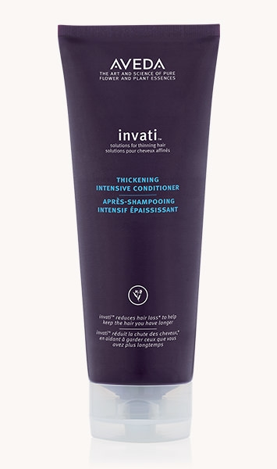
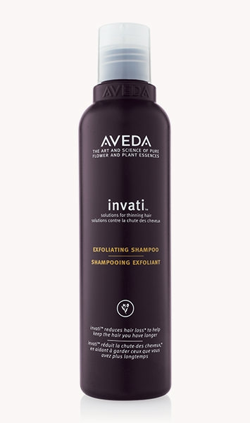
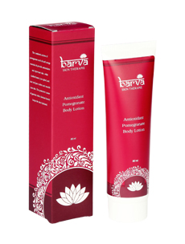
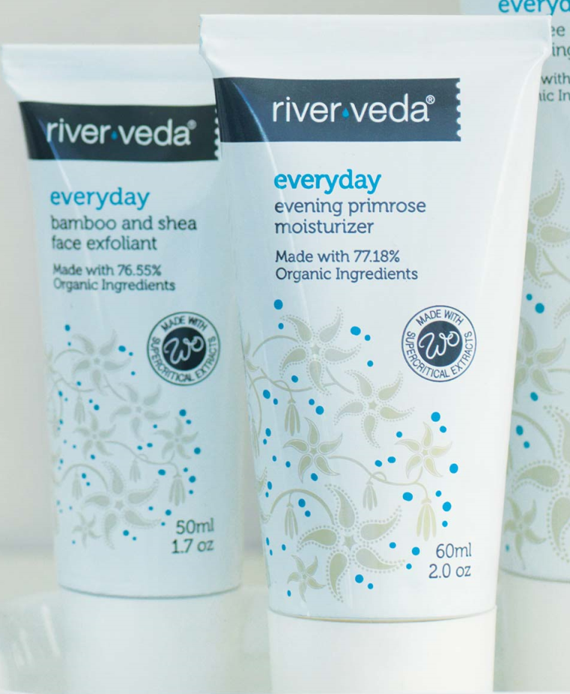
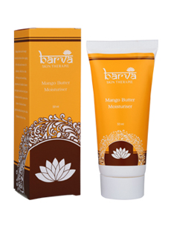
Body care products
http://happyfamily.org.in/
www.worldorganics.com
www.aveda.com
Creams, lotions, shampoos, conditioners, soaps

Slide 27
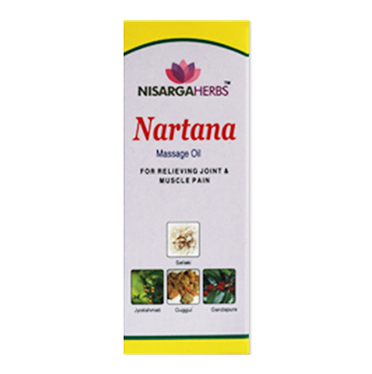
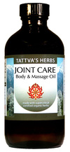
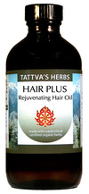
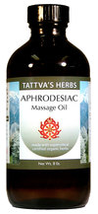
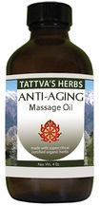
Massage and therapeutic oils

Slide 28
Advantages of using CO₂ extracts in topical healthcare applications
Low concentration required
Better stability of products
Easy to solubilise in cosmetic products as it is lipid soluble in nature
Absorption and efficacy is much better than other extracts
Very low microbial count
No presence of heavy metals as it is a big issue in cosmetics in modern times

Slide 29
Ingredients & functional properties
Eclipta alba | Hair care & Body care | It is used to prevent scalp infection &excellent conditioner. In massage oils it gives a soothing action on mind activity
Ginger Lily | Hair care & Skin care | It acts as a stimulant in skin care & hair care products
Turmeric Oil | Skin care & Body care | It protects skin from effect of environment chemicals & sunrays. It has a cleansing action on blood, muscular tissues and skin. It increases luster on skin. It acts as a anti-oxidant & anti-fungal agent
Hemidesmus indicus | Skin care & body care | It reduces burning sensation and irritation of skin. It also gives cooling sensation to the skin and removes bad body odor
Ginger | Hair care & skin care | It stimulates hair growth. It improves light colored scares.

Slide 30
Ingredients & functional properties
Fenugreek Oil | Hair care & Body care | In hair care products e.g. in shampoo it acts as a excellent conditioner and also acts as a anti-microbial & anti-oxidant agent. In body care products. It is used for cholesterol reduction
Brahmi | Hair care & body care | In body care products it deeply stimulates the nervous systems by releasing neuro hormones & creating a feeling of relaxation and pleasure. It helps to imparting restful calm sleep & also improves intelligence & other brain functions. In hair care products it is used for hair growth & as a conditioner
Neem | Hair care, Skin care, body care | In hair care products e.g. shampoo & hair oils, it acts as a anti dandruff agent, it cleanses the scalp off unpleasant dandruff. In skin care products it acts as a anti-bacterial agent. It helps to reduce the appearance of dark spots without any skin irritation. It is also an anti-oxidant.

Slide 31
Ingredients & functional properties
Cyperus | Skin care & hair care | It sooth & calm the mind and increases objectivity in skin care & hair care products. Known as a good skin & scalp conditioner
Basil | Skin care, hair care & body care | In skin care & hair care products it acts as a anti-bacterial, it helps to reduce the appearance of dark spots without any skin irritation Known as anti-oxidant.
Calendula | Skin care | It improves glow on face & helps to reduce wrinkle on face. It improves overall complexion of skin. It is also used to cure skin wounds, rashes, inflammation & bites
Amla | Hair care & skin care | It strengthens hair roots and promotes long, lustrous and healthy hair. It is promotes glow on skin and delays wrinkles or loosening of skin.

Slide 32
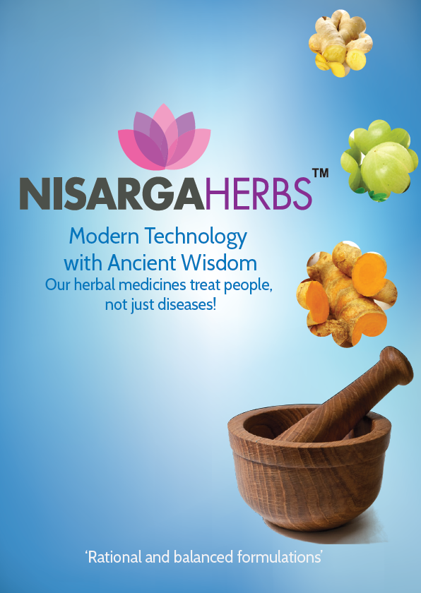
Herbal supplements
Our ethically Promoted brand in India (sold only through prescriptions by doctors)

Slide 33
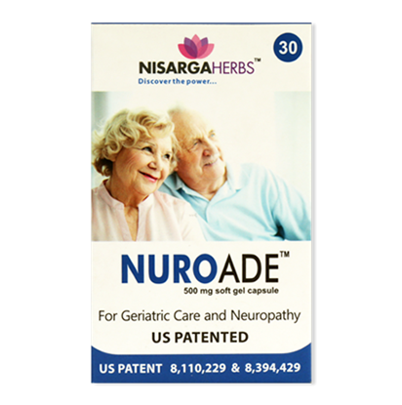
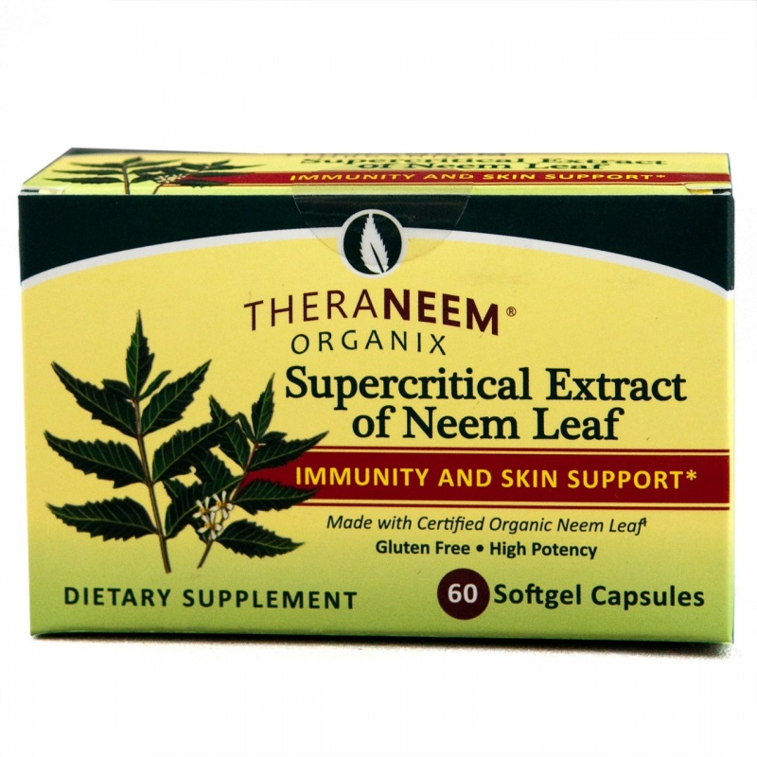
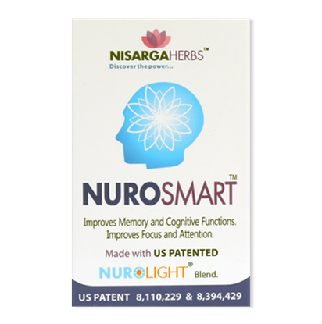
Soft Gel Capsules
Our patented product for children based on ADHD patent
Based on memory improvement patent

Slide 34
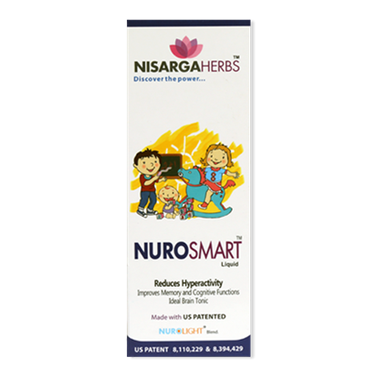
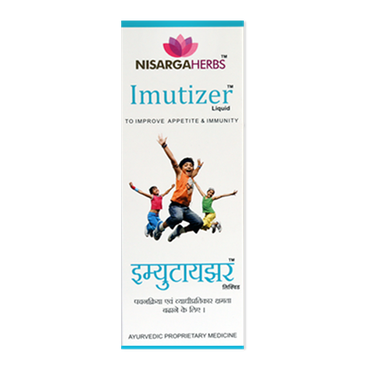
Syrups for healthcare

Slide 35
Holistic extracts
A combination of CO₂ extracts and hydrophilic extracts
Benefits:
Gives you the entire profile of the herb in a very concentrated form(1 gram extract is equivalent to 12 grams of actual raw herb).
The lipid soluble CO₂ extracts help the polar compounds to be absorbed faster in the system demonstrating noticeable results
As cell membrane is made up of lipids, absorption of lipid molecules is better.
Can cross GI track barrier easily and may help cross blood brain barrier
Does not inhibit enzymes responsible for drug assimilation
Enhances bio availability

Slide 36
Our most successful holistic extracts
Turmeric
Ashwagandha
Neem
Amla
Ginger
Holy Basil
Boswellia
Cinnamon
Moringa
Andrographis
Green Tea

Slide 37
Advantages of Holistic extracts in our proprietary products
Our dosages of herbs per capsule/tablet are in multiples of others, due to highly potent & potentiated holistic extracts
Low and palatable dosages (1 cap OD/BID).
With the use of minimum number of herbs and potent extracts, we can ensure necessary therapeutic dosage of each herb in the formulae.
Use of minimum number of herbs reduces possibility of drug interaction.

Slide 38
Special Features of Nisarga Products
Majority ingredients in our formulae are known “Rasayana” herbs,
“Rasayana” herbs (or Adaptogens) are known to
Has apparently antagonistic constituents having complimentary activities.
Stabilize plasma membrane and maintain optimum level of cell structure and function.
Create balance of bio energies, thus improving balance in body metabolism.
Known to be safe for long term use without any side effects at given dosages.

Slide 39
Nisarga’s holistic extract study- Turmeric
We have succeeded in our research effort to confirm
improved bioavailability
non interference with CYP3A4 enzyme activity.
Results were confirmed by
A bioavailability study comparing
Pure curcumin 99%
Available marketed extract by other companies in USA containing curcuminoides 95% with 72% curcumin
Our patented holistic extract containing 45% curcuminoides with 35% curcumin and 5% turmorones which are lipid soluble in nature
A in-vitro study comparing the inhibition of CYP3A4 enzyme when used at different concentration of curcumin, active principle present in our holistic turmeric extract.
.

Slide 40
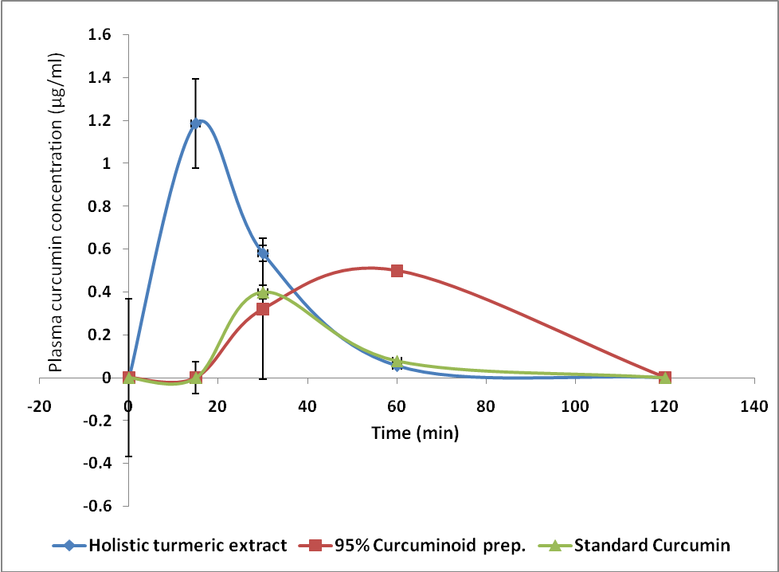
Comparison of bioavailability of our holistic extract

Slide 41
Comparison of CYP3A4 metabolism
Standard curcumin (μg/ml) | Standard (99% Pure) Curcumin | 95% curcuminoids (72% Curcumin) | Nisarga’s Turmeric extract (45% curcumin, 5% turmerones)
0.1 | 23.91 | -17.87 | -52.19
0.2 | 38.83 | -8.92 | -31.30
0.5 | 47.78 | -2.95 | -26.82
1 | 53.75 | 3.02 | -20.86
2 | 67.17 | 8.98 | -16.38
5 | 76.13 | 44.79 | -11.90
10 | 80.60 | 47.78 | -2.95
20 | 83.59 | 62.70 | 1.52
Nisarga’s holistic extract did not cause CYP3A4 inhibition even at a high concentration of 20μg/ml.

Slide 42
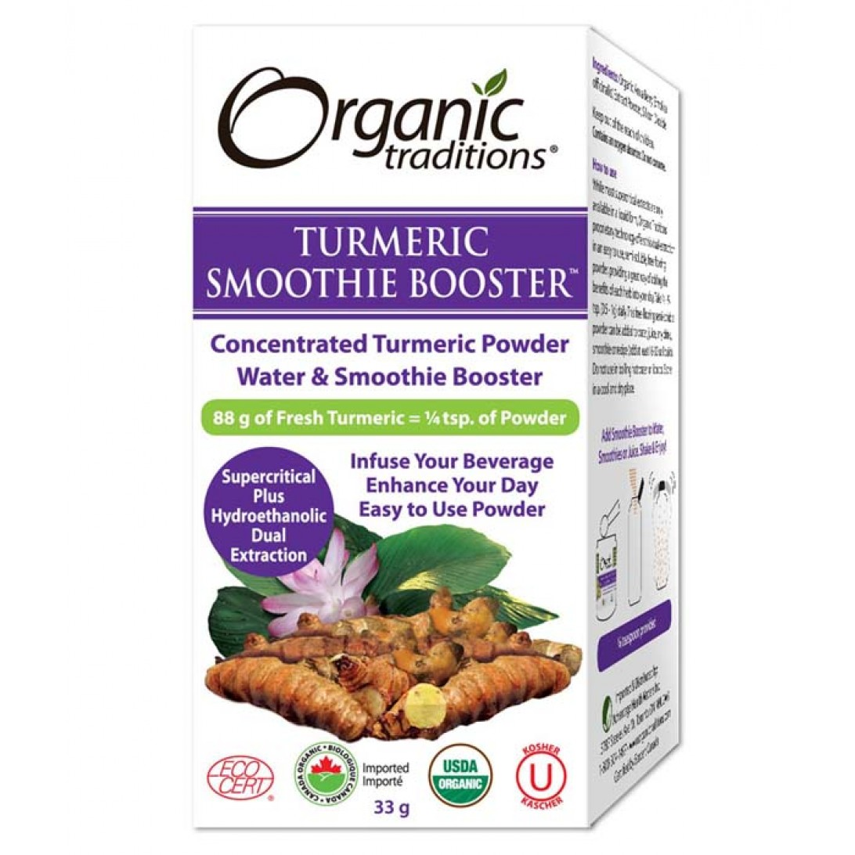
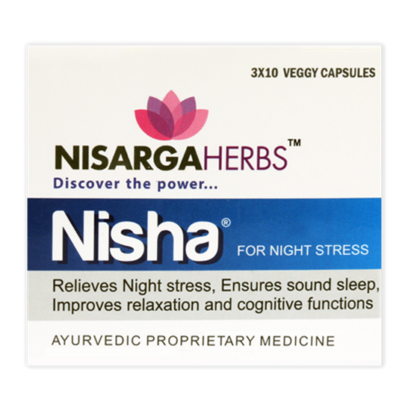
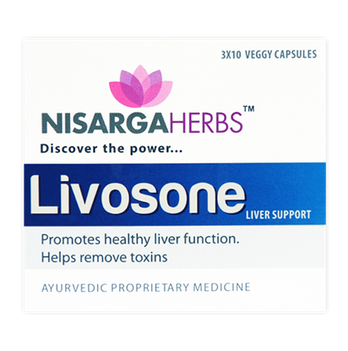
Where can holistic extract be used?
Capsules, Tablets, food products, flavouring agents for herbal teas

Slide 43
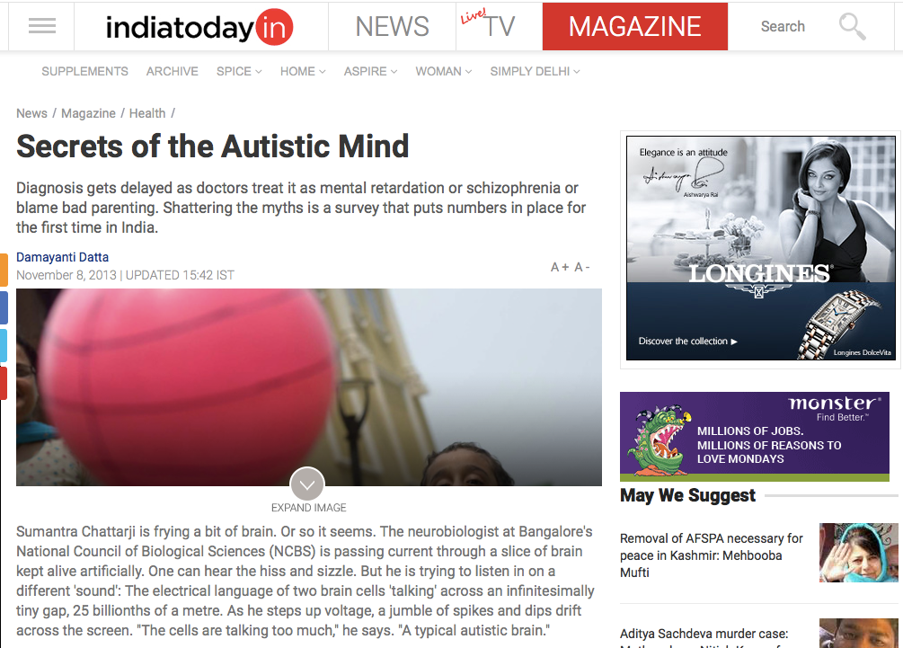
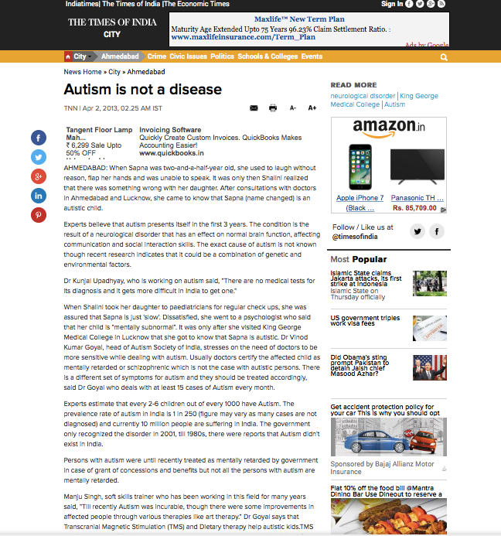
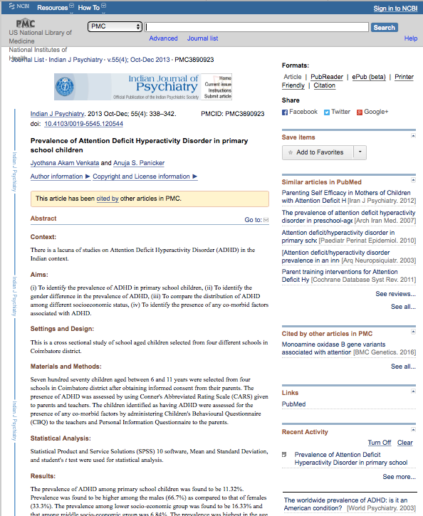
Need for Neurological products in India for children
“More than 10 million children in India
suffer from autism”
Source: India Today, November 8, 2013
Prevalence rate of autism
in India: 1 in 250
Source: TNN, April 2, 2013
11.32% of primary school children
in India have ADHD
Source: Indian Journal of Psychiatry, Oct-Dec, 2013

Slide 44
Our product for neurological ailments in children

Slide 45
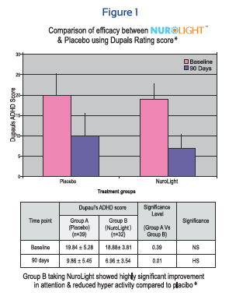
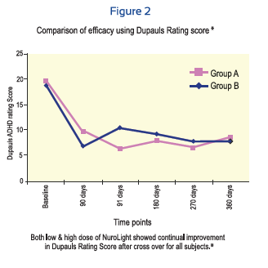
crossover

Slide 46
Nurosmart

Slide 47
Safety profile

Slide 48
Nartana Clinical trial published on PubMed

Slide 49
Nartana
Ingredients:
Ashwagandha
Tribulus terrestris
Tinosporia Cordifolia
Boswellia Serrata
Ginger
Dosage: 1 capsule BID
Indications:
Rheumatoid arthritis
Osteoarthritis
Spondylitis
fibromyalgia

Slide 50
Trial parameters
Trial conducted by renowned Dr Milind Modak (MS Ortho) at Dinanath Mangeshkar Hospital,Pune.

Slide 51
Nartana Clinical trial data

Slide 53
Innovation and way forward…
Development of a new delivery system of natural products through nebulization techniques
Vapor delivery system where the digestive tract is completely avoided
Effective for use in people with compromised gut function
Instant absorption and delivery into the blood stream
Inhaling CO₂ extracts with no artificial additives, carriers or fillers
Toxicity studies in animals show no toxicity of CO₂ extracts through this delivery system

Slide 54
What can we do for you?
Supply organic extracts of both types- CO₂ as well as holistic extracts
Supply liquid-lipid CO2 extracts that are organic and completely miscible in water
Develop formulations for supplements and personal care products (prototypes)
We can help research and develop Ayurvedic fragrances and actives of Amway’s choice for personal care as well as supplement formulations
Stability testing and validation of current products with the use of CO₂ extracts
Our own products for licensing/ private label
Exclusive formulations

